Slide 1

RANI CHANNAMMA UNIVERSITY, BELAGAVI
School of Mathematics and Computing Sciences
DEPARTMENT OF COMPUTER SCIENCE
Presentation On
“wholesale management system”
Submitted by
Mr. Shivanand Chavan.
MSc 1st Semester
December -2018

Slide 2
Problem Definition:
This project aims to develop sales management web application for a wholesale business to improve the efficiency and security of the business.
The lightweight nature of the web application makes it ideal for small businesses which cannot afford the expensive alternates present in the market.

Slide 3
The Purpose:
The Main objective of this project is to develop software to show the details of stock like their id, name, quantity and details of customer i.e name, id, address. Registration, Updating, transaction.

Slide 4
HARDWARE AND SOFTWARE REQUIREMENTS:
Hardware requirements :
Processor: intelcore i5 processor.
Hard disk: 40GB
RAM: 4 GB
Software requirements :
Web technology: HTML,JS,CSS
Editor:Notpad++
Operating system: windows 7 on words

Slide 5
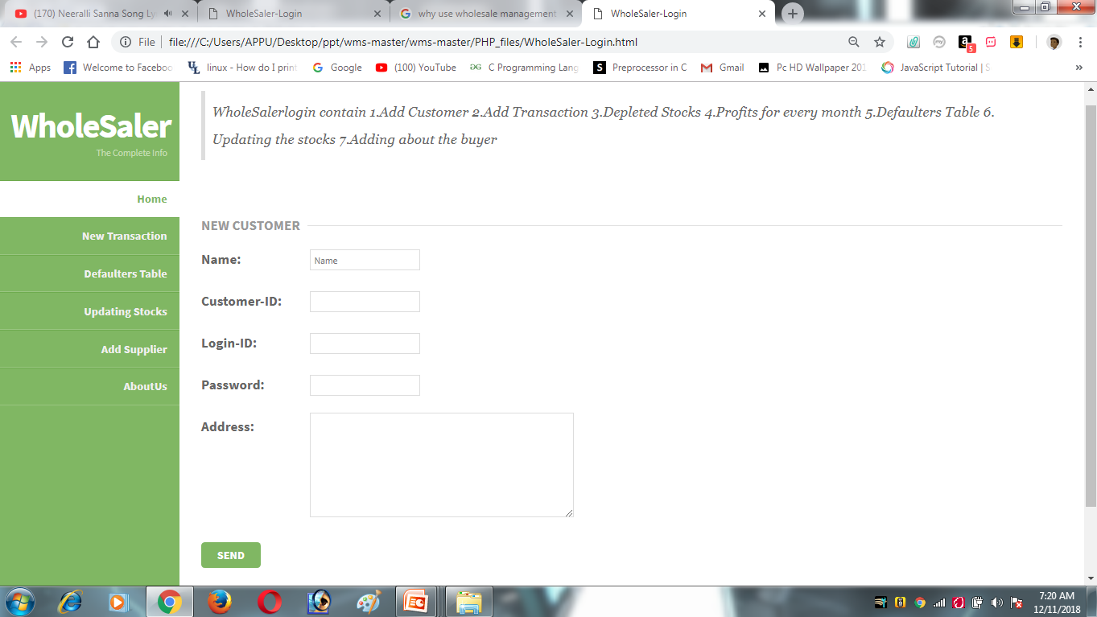
New Customer:

Slide 6
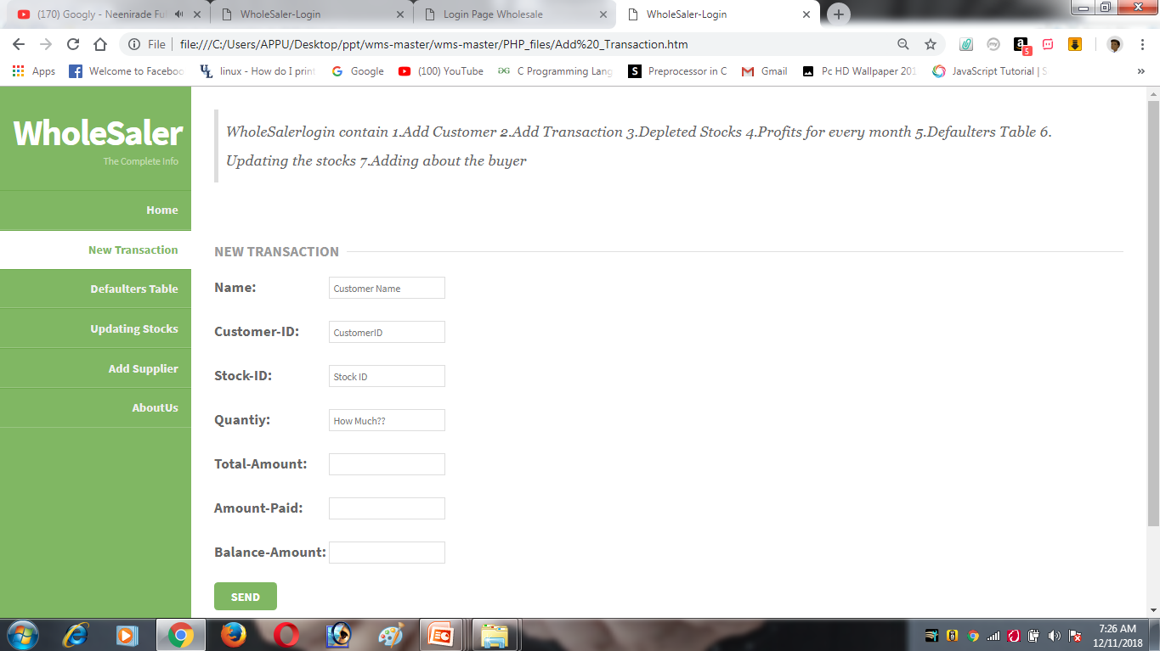
New Transaction:

Slide 7
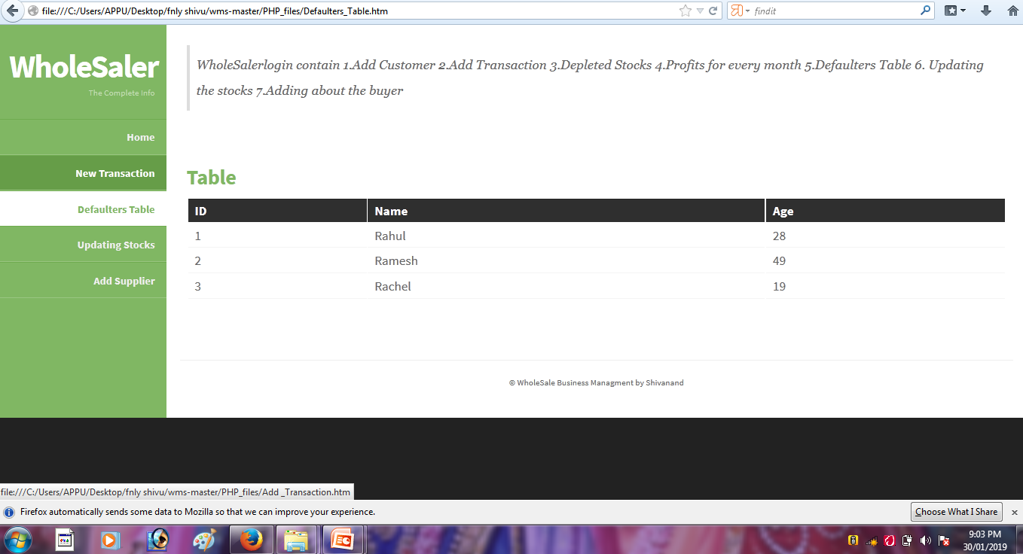
Defaulters Table:

Slide 8
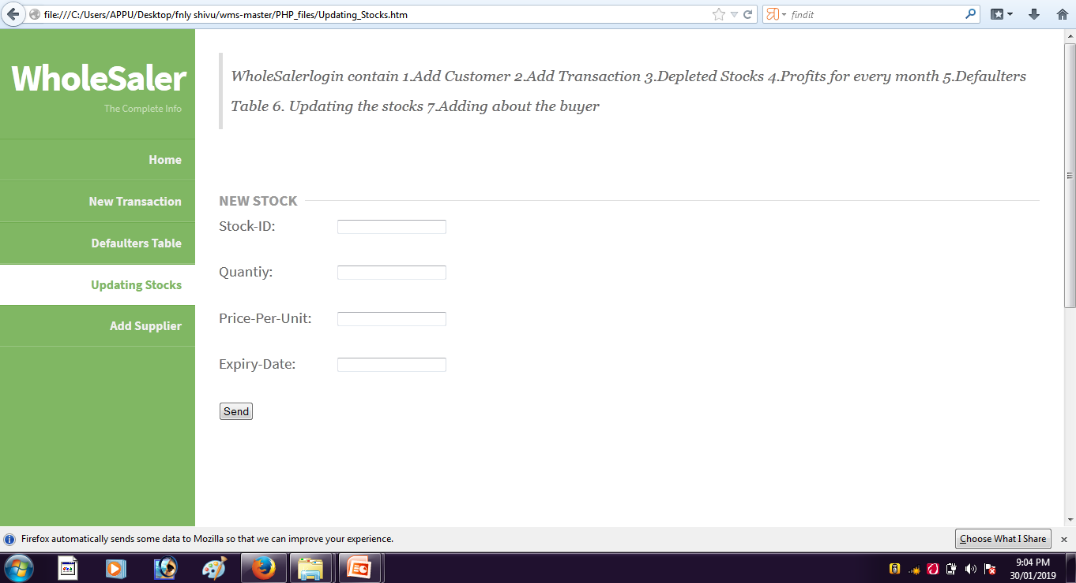
Update Stocks:

Slide 9
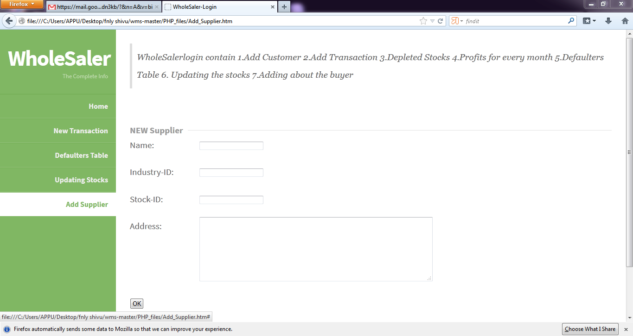
Add Supplier:

Slide 10
Thank you

